Slide 1
Recitation: Homework 1, Problem 2
Brandon Lim, Carson Earl, Charlie Ryan, Tristan Leeroff

Slide 2
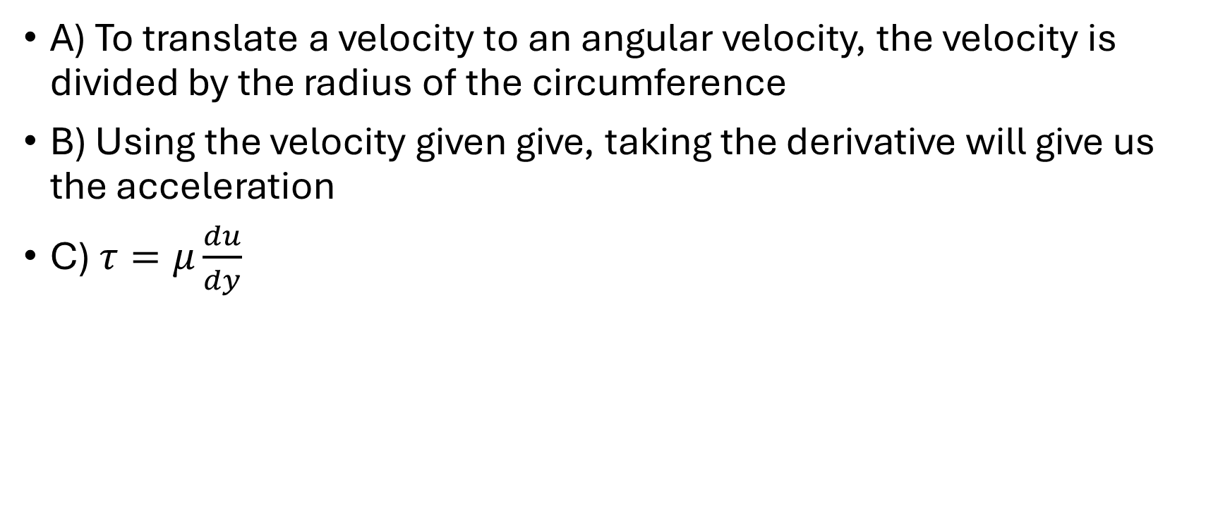
Approach
A) To translate a velocity to an angular velocity, the velocity is divided by the radius of the circumference
B) Using the velocity given give, taking the derivative will give us the acceleration
C) $τ=μ\frac{du}{dy}$

